Slide 1
Phase 2
FX and IR management
Draft - for discussion purpose only

Slide 2
FX hedging and trading operations
  The London financial commodity desk acts as a satellite desk to the Houston operations, with one central FX book being managed
  Both the London and Houston desks trade in FX positions with a “prop” book recording these deals separately from the Hedge book, however London prop deals are only entered into on behalf of Houston due to SFA limitations
  The London desk enters approximately 3 - 5 prop trades per week and approximately 10 - 15 hedging trades (including rollovers) per day
  Commodity desks converse with the FX desk in preparing for deals, the desk advises on market conditions and rates
  FX hedging is initiated by the commodity desks contacting the FX desk

Slide 3
FX hedging and trading operations
  The FX/IR desk does not always hedge 100% of small FX exposures (< $500 equiv.) and does not perfectly hedge short IR exposures (< 1 year) through the forward FX market
  Infinity reports hedge positions by commodity desk daily, which is available on the S:\ drive in Excel format
  A long dated exposure will require the FX desk to liaise with the IR trader to trade in both the FX spot market and in the forward, swap and bond interest rate markets
  Short dated exposures (up to 2 years) are hedged in the forward FX market

Slide 4
IR Exposure
  Desks calculate their own rho and theta. Theta and Rho rely on the book curve being used, therefore a GBP book will calculate theta and rho on the GBP value of the deals booked
  Forward cashflows are consolidated from each desk into Infinity via the Auto-Rho process except in the case of coal which manually report Rho daily to Houston
  Interest rate exposure is managed globally by Houston, using the Auto-Rho reports. Auto-Rho apply the US Prime and European yield curves for each currency, and reports by currency and time bucket.
  The London financial trading desk receives Infinity interest rate exposure reports for EUR, GBP, NOK and SEK twice daily by fax, and manages these exposures
  Houston input US and Canadian interest rate curves into Infinity and the London desk inputs European interest rate curves
  The closing US interest rate curves and spot rates are passed to the books via Infinity downloads to the S drive in the morning of the following day for their own DPRs

Slide 5
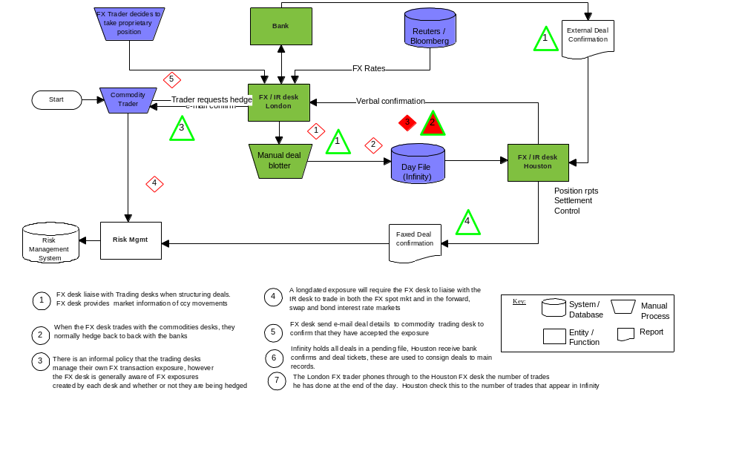
FX operations

Slide 6
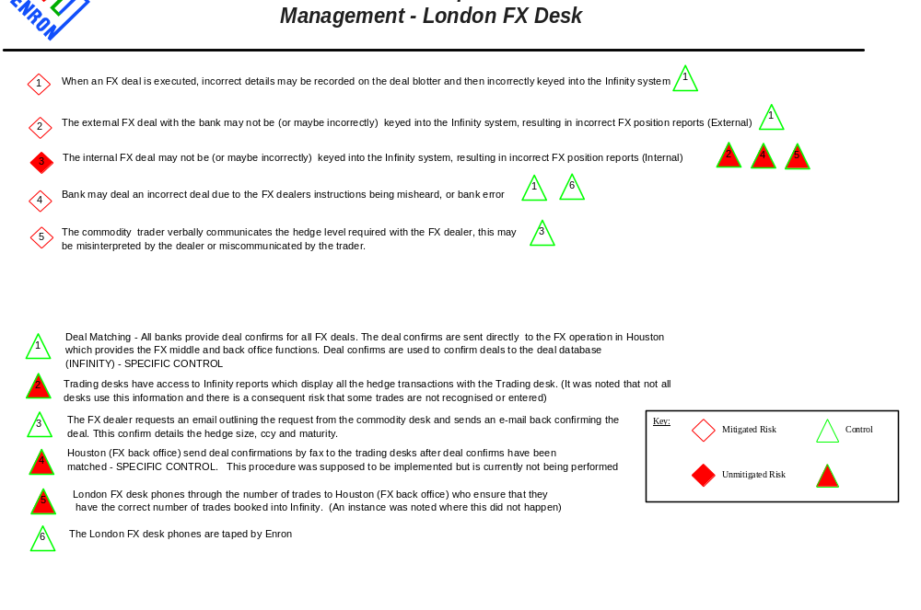
FX operations

Slide 7
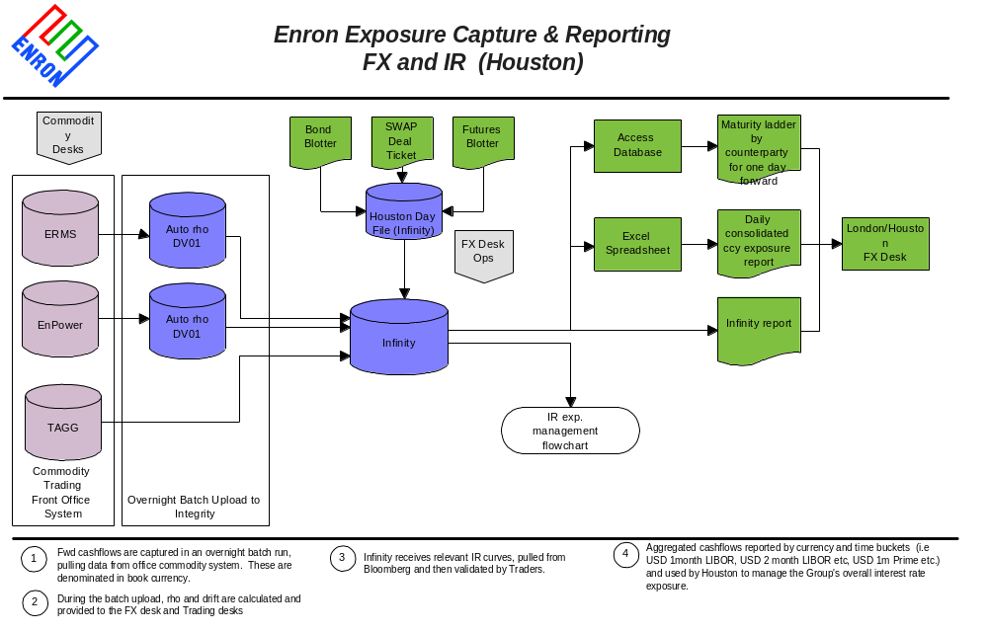
FX operations

Slide 8
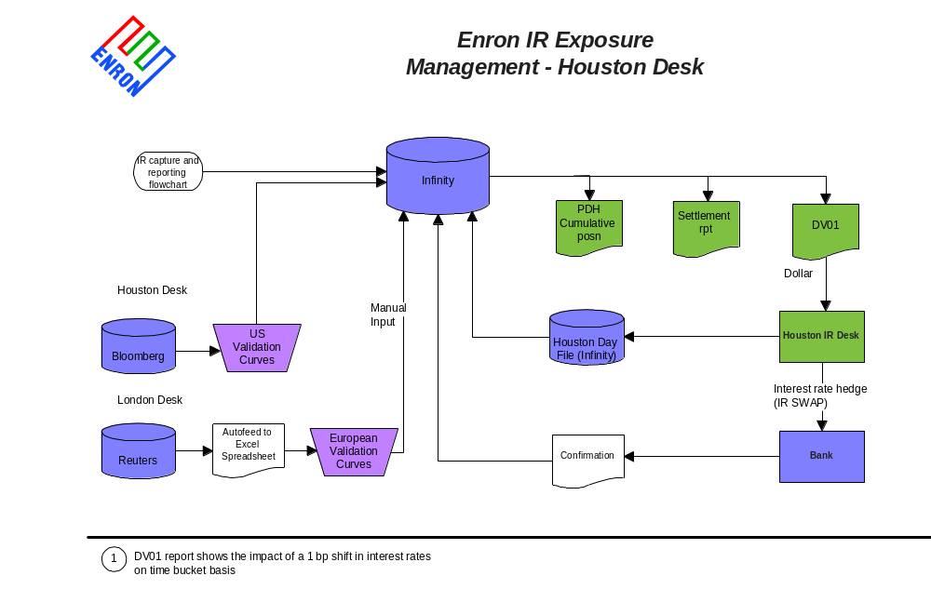

FX operations

Slide 9
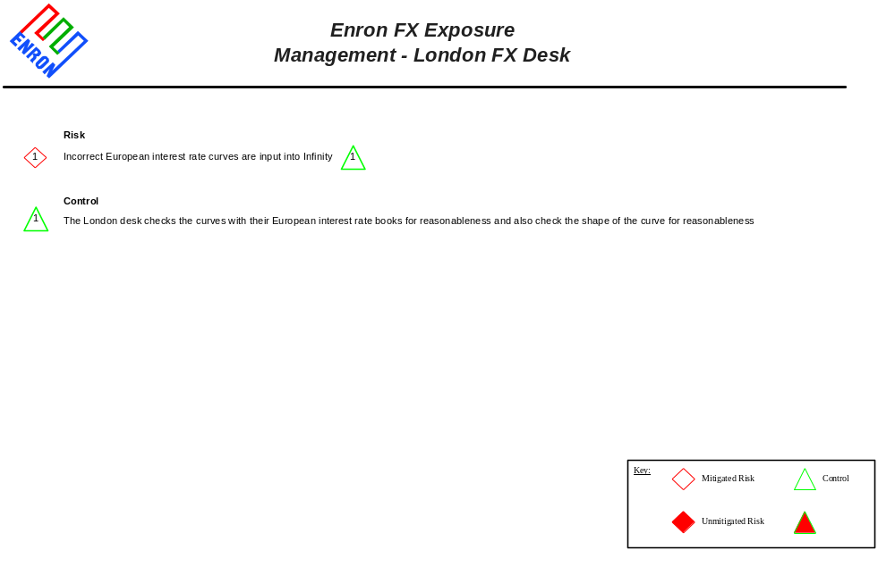
FX operations

Slide 10
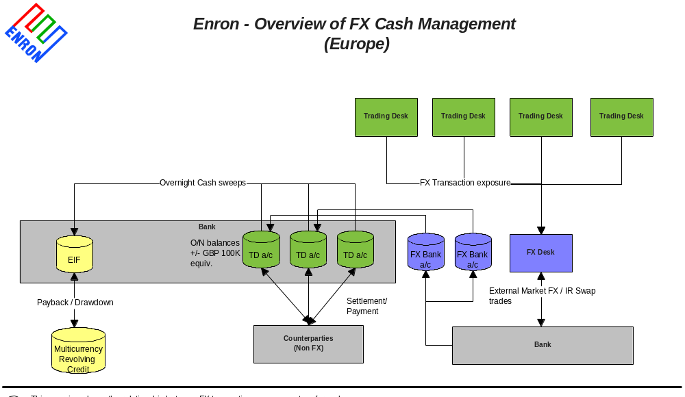
FX operations

Slide 11
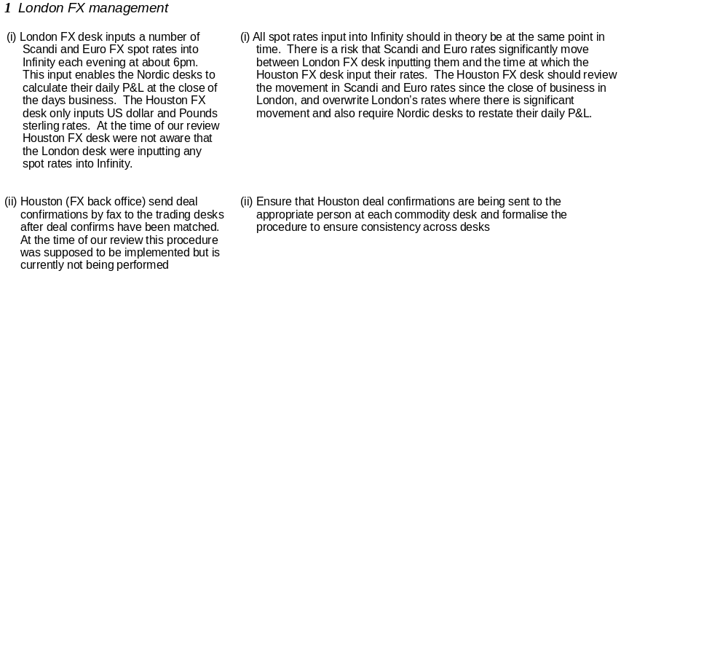
Proposed Priority Status
Issues
Proposed Action Plans
Low
Medium
High

Slide 12
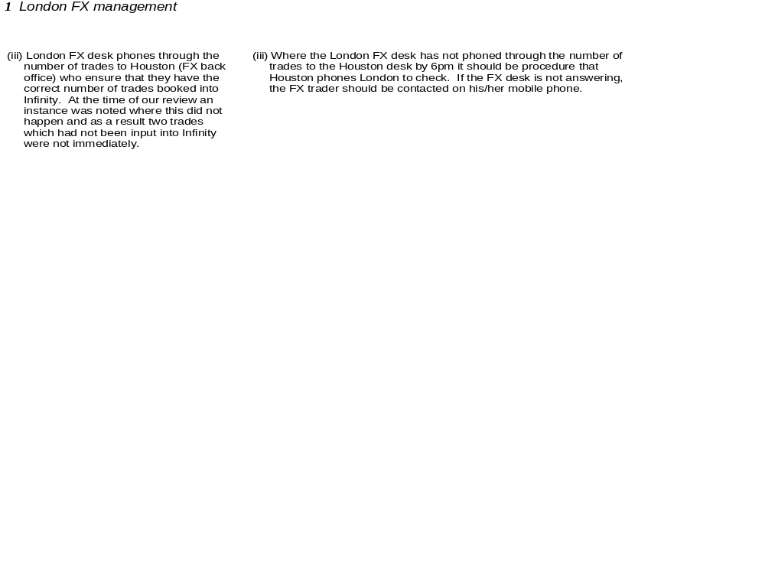
Proposed Priority Status
Issues
Proposed Action Plans
Low
Medium
High

